Slide 1

MORE THAN READY.
LOYOLA READY.

Slide 2
Redlining and Baltimore
Messina MA251.02V
Fall 2021

Slide 3
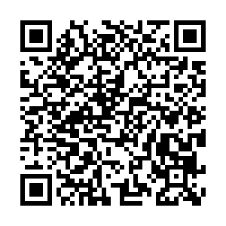
Baltimore
Where is ?
pollev.com/loberbro

Slide 4
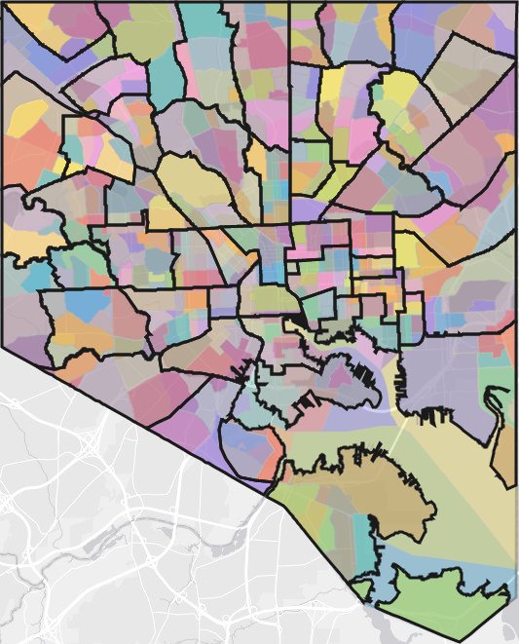
BALTIMORE https://bniajfi.org/exploregeography/
Loyola
M&T Bank (Ravens) Stadium
Barclay
Sandtown-Windchester

Slide 5
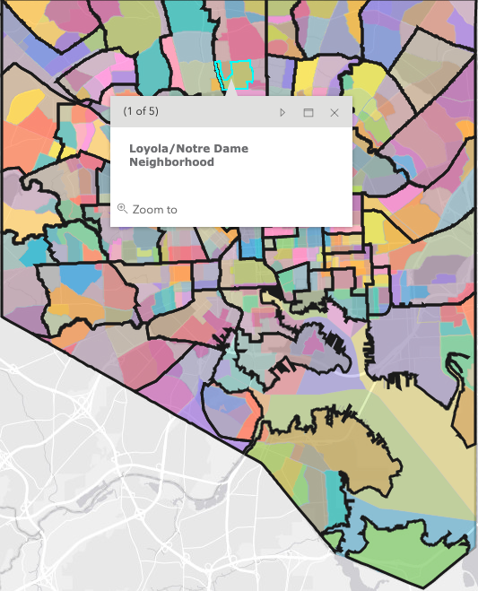
BALTIMORE https://bniajfi.org/exploregeography/
Loyola
M&T Bank (Ravens) Stadium
Barclay
Sandtown-Windchester

Slide 6
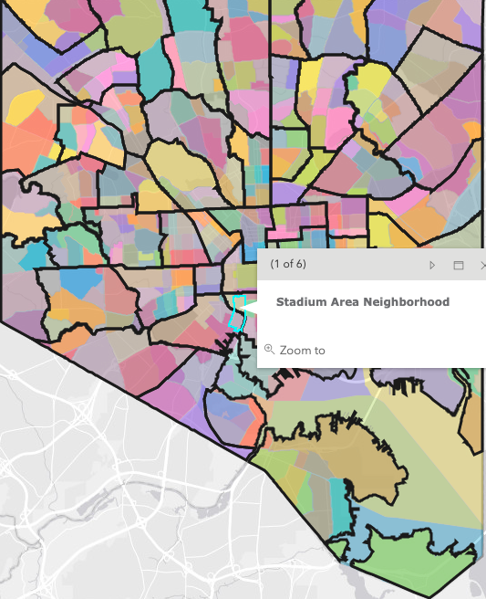
BALTIMORE https://bniajfi.org/exploregeography/
Loyola
M&T Bank (Ravens) Stadium
Barclay
Sandtown-Windchester

Slide 7
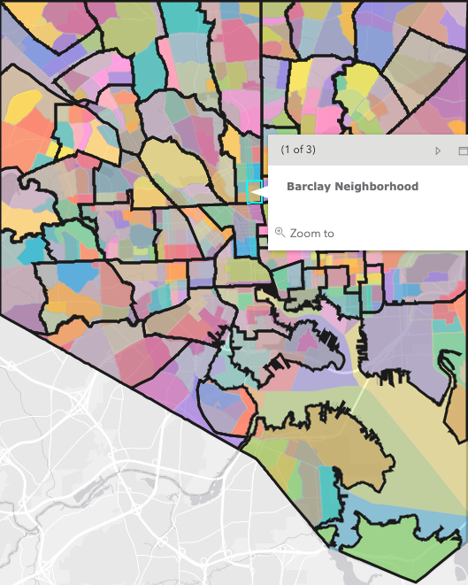
BALTIMORE https://bniajfi.org/exploregeography/
Loyola
M&T Bank (Ravens) Stadium
Barclay
Sandtown-Windchester

Slide 8
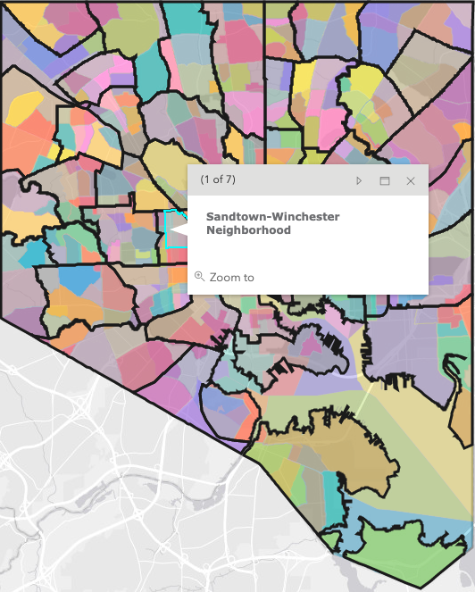
BALTIMORE https://bniajfi.org/exploregeography/
Loyola
M&T Bank (Ravens) Stadium
Barclay
Sandtown-Windchester

Slide 9
Baltimore: infamous for redlining and
Housing discrimination
Late 1800s to mid-1900s in Baltimore
Discriminatory housing practice - a way of “block-busting” Red neighborhoods = high financial risks
Home values suffered
Families had a difficult time moving away (“moving up”)
Disinvestment in those neighborhoods
Contributed to housing segregation and systemic poverty

Slide 10
Baltimore City Ordinance 610 (1910)
The Baltimore Sun summarized the ordinance's provisions as follows:
That no negro can move into a block in which more than half of the residents are white.
That no white person can move into a block in which more than half of the residents are colored.
That a violator of the law is punishable by a fine of not more than $100 or imprisonment of from 30 days to 1 year, or both.
That existing conditions shall not be disturbed. No white person will be compelled to move away from his house because the block in which he lives has more negroes than whites, and no negro can be forced to move from his house if his block has more whites than negroes.
That no section of the city is exempted from the conditions of the ordinance. It applies to every house.
In addition, the ordinance prohibited negroes from using residences on white blocks as a place of public assembly and vice versa.
Garrett Power, Apartheid Baltimore Style: the Residential Segregation Ordinances of 1910-1913, 42 Md. L. Rev. 289 (1983) Available at: http://digitalcommons.law.umaryland.edu/mlr/vol42/iss2/4

Slide 11
Housing covenants
1920s: Roland Park, Guilford, and Homeland covenants (started in 1890s)
Annexed into the city in 1918
Other developers across the country used these covenants as examples

Slide 12
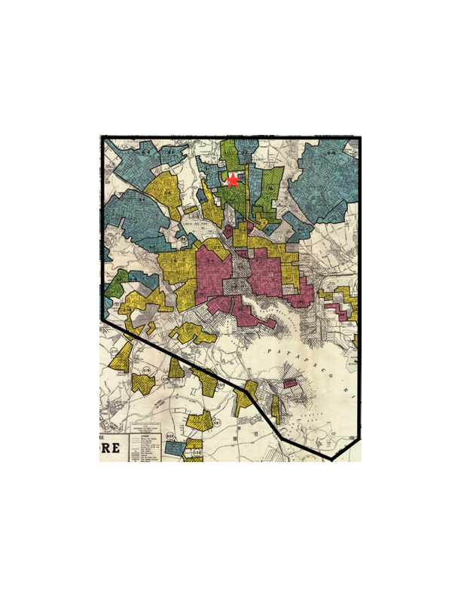
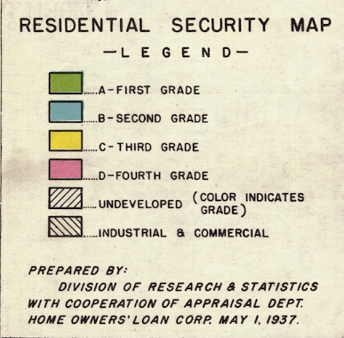
Redlining:
1937 Security Map
Green: "Best"
Blue: "Still Desirable"
Yellow: "Definitely Declining"
Red: "Hazardous"

Slide 13
Redlining:
1937 Security Map
Green: "Best"
Blue: "Still Desirable"
Yellow: "Definitely Declining"
Red: "Hazardous"

Slide 14
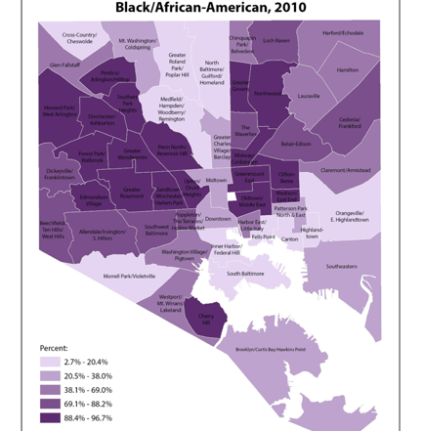

Black butterfly white l

